Slide 1
Web Frame Work Using JavaScript
Vivek Sharma
Notes:
This template can be used as a starter file for presenting training materials in a group setting.
Sections
Sections can help to organize your slides or facilitate collaboration between multiple authors. On the Home tab under Slides, click Section, and then click Add Section.
Notes
Use the Notes pane for delivery notes or to provide additional details for the audience. You can see these notes in Presenter View during your presentation.
Keep in mind the font size (important for accessibility, visibility, videotaping, and online production)
Coordinated colors
Pay particular attention to the graphs, charts, and text boxes.
Consider that attendees will print in black and white or grayscale. Run a test print to make sure your colors work when printed in pure black and white and grayscale.
Graphics, tables, and graphs
Keep it simple: If possible, use consistent, non-distracting styles and colors.
Label all graphs and tables.

Slide 2
The Course Break Down:
Class 1: Mean Stack Fundamentals.
Class 2: Learning Node.js
Class 3: Implementing HTTP Services in Node.js
Class 4: Scaling the Applications Using Node.js
Class 5: Understanding NoSql and MongoDB
Class 6: Understanding Express and Implementation.
Class 7: Understanding Angular
Class 8: Understanding the Angular Directives and Angular Web Application.
Class 9: Creating a Shopping Cart.
Class 10: Creating another project.
Notes:
Give a brief overview of the presentation. Describe the major focus of the presentation and why it is important.
Introduce each of the major topics.
To provide a road map for the audience, you can repeat this Overview slide throughout the presentation, highlighting the particular topic you will discuss next.

Slide 3
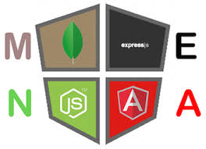
Welcome

Slide 4
Some Points before we start off:
Introduction.
Grading/ Assignments.
About the Class. [Basic to Professional]
Pace.
Interview Preparation.
Labs.

Slide 5
Today’s Overview
1
2
Brands, Models and Platforms.
3
Considerations for the Mobile Development.
The Mobile Ecosystem.
4
Types of Mobile Apps
Notes:
This is another option for an overview slide.

Slide 6
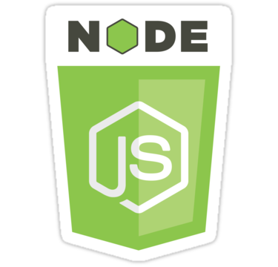
Node.JS
Notes:
Use a section header for each of the topics, so there is a clear transition to the audience.

Slide 7







JavaScript is everywhere!

Slide 8

JavaScript on the Browser
Math
String
Array
Native Objects
(JS runtime)
DOM
Window
Document
History
Host Objects
(Browser API)

Slide 9



Slide 10

=Server Side Javascript:

Slide 11

JavaScript on the Server
Math
String
Array
Native Objects
(JS runtime)
fs
http
https
Host Objects
(C++ API)

Slide 12


JavaScript on the Server Side

Slide 13
What is Node:
Developed by Ryan Dahl in 2009.
The main motivation :
Concurrency issues while dealing with Web Services.
Google at that time had just come out with its CHROME V8 JS engine which was highly optimized for the Web Traffic. Dahl created Node.js on top of V8 as a server-side environment that matches the client-side environment in the browser.
Result
Extremely scalable server-side environment that allows developers to more easily bridge the gap between client and server.
Developers can easily navigate back and forth between client and server code and can even reuse code between the two environments.
“Node.js is a website/application framework designed with high scalability in mind. It takes advantage of the existing JavaScript technology in the browser and flows those same concepts all the way down through the webserver into the backend services. Node.js is a great technology that is easy to implement and yet extremely scalable.
Node.js is a very modular platform, which means much of the functionality that you will use is provided by external modules rather than being inherently built into the platform. The Node.js culture is very active in creating and publishing modules for almost every imaginable need.

Slide 14
Use Cases Node Is Solving.
 Soft Real-Time Push-Based Applications
 twitter, chat, sport bets, mobile, …
 SPA
 many req/sec with low response times, sharing things like validation code between the client and server, FAT client
 Cloud
 SaaS, PaaS, DBaaS

Slide 15

Motivation: grow
Performance + Scalability
Concurrency
Rapid Change
Cloud
Mobile
IoT
Data Volume
Integration
Enterprise Service Farms

Slide 16
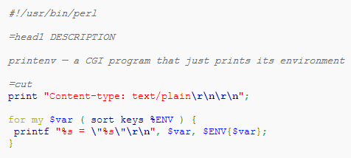
CGI (1993)
a process/request

Slide 17
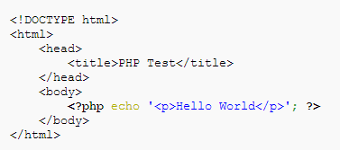
PHP (1994)
a thread/request No Pooling

Slide 18
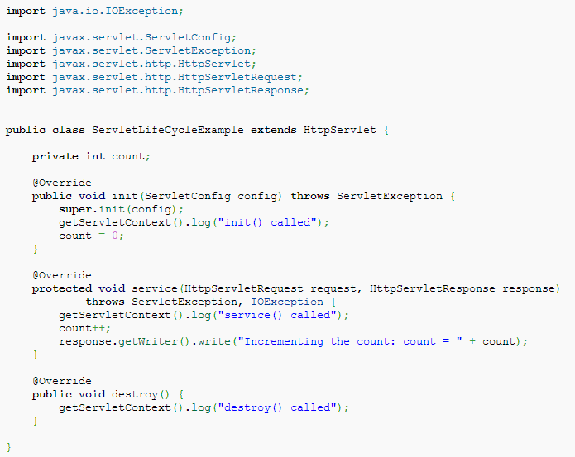
Java Servlet (1995)
a thread/request
with pooling in container = pre-allocation

Slide 19
Problem 1?
Context switching is not free
Execution stacks take up memory
A quick calculation: assuming that each thread potentially has an accompanying 2 MB of memory with it, running on a system with 8 GB of RAM puts us at a theoretical maximum of 4000 concurrent connections, plus the cost of context- switching between threads.
For massive concurrency,
cannot use an OS thread for each
connection

Slide 20
Problem 2?
We always do I/O
result = db.query("select
somthing from T");
// use result
which is blocking
Blocked = Totally Stuck no events no rendering no anything stuck!

Slide 21
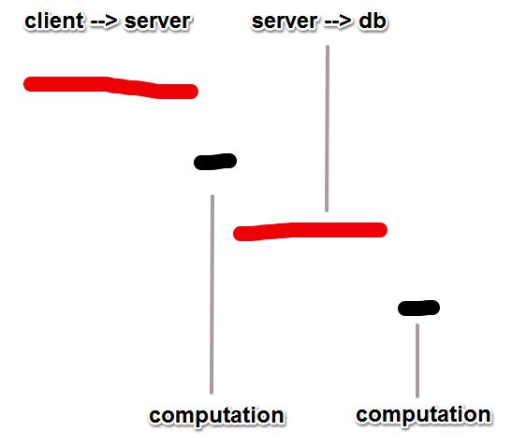
I/O latency
L1: 3 cycles
L2: 14 cycles
RAM: 250 cycles
DISK: 41,000,000 cycles
NETWORK: 240,000,000
cycles

Slide 22

Non-Blocking IO

Slide 23
Non-Blocking IO
Callbacks + Polling
Epoll, POSIX AIO, …
Event-Driven
While there are events to process e = get the next event
perform the action requested by e in a thread
if e’s thread is complete and e has an associated callback call the callback

Slide 24
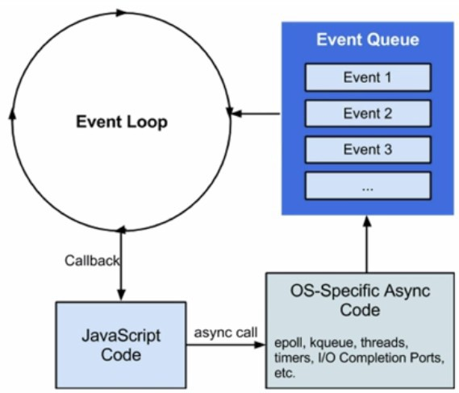
Event Loop

Slide 25
Now…
var result = null;
db.query("select..", function (passedResult) {
// use passed result… result = passedResult;
});
console.log( result ); // what’s result now?

Slide 26
Concurrency
Concurrency allows multiple things to happen at the same time
Concurrency is common (required) on the server side as many users will access the server at the same time
Java will spawn a new thread with each new connection >> consuming resources
JavaScript is single threaded, yet still somehow achieves very high concurrency and can handle heavy amounts of I/O
Other scripting languages are completely incapable of handling this, blocking the entire process when a web request arrives

Slide 27


Concurrency Models
Thread-based
 Locks and Shared State
VS
Event-driven Concurrency
 I/O parallelism without requiring CPU parallelism
 no synchronization is required
 maximize resource efficiency

Slide 28
Where were you!?
Why everyone isn’t using event loops, callbacks, non-blocking IO?
 Cultural
 Infrastructural

Slide 29
Cultural
This is How we’re taught I/O:
puts("Enter your name: " var name = gets(); puts("Name: " + name);

Slide 30
Cultural (2)
Rejected as too complicated
puts("Enter
your name: ");
gets(function puts("Name:
});
(name) {
" + name);

Slide 31
Missing Infrastructure
Single threaded event loops require I/O to be non-blocking
Most libraries are not.

Slide 32
Too Much Infrastructure
EventMachine, Twisted, Mina, Java nio, …
AnyEvent,
Apache
users are confused how to combine with other available libraries

Slide 33
Why Javascript?
Javascript designed speciﬁcally to be used with an event loop purely:
 Anonymous functions, closures
 Only one callback at a time
 I/O through DOM event callbacks
 culture of Javascript is already geared towards evented programming

Slide 34
Enter Node.JS?

Slide 35
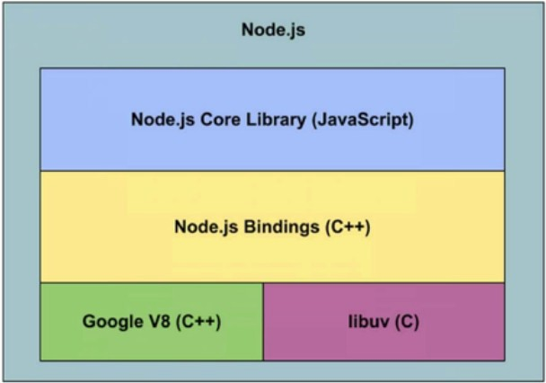
Node.js Architecture
Open source JavaScript engine, Optimizer, JIT, inline caching, GC
Cross-platform asychronous I/O

Slide 36


Why Node.JS?
Node.JS is great for real time applications with many connections simultaneously sending information
Generating High I/O >> Requiring High Concurrency

Slide 37

Why Node.JS?
High I/O in other languages
Most Languages: Java, Ruby, Python and PHP
Web Request
var user = sync.IOcall( ID )
{ do something }
Blocked thread/process
Must wait till done
Java: spawn a new thread
Web Request
var user = sync.IOcall( ID )
{ do something }
Web Request
var user = sync.IOcall( ID )
{ do something }
Web Request
var user = sync.IOcall( ID )
{ do something }

Slide 38

Why Node.JS?
High I/O + High Concurrency
Web Request:
I/O Call Function
CallBack Function
Web Request:
fs.readFile ( ‘filename’ , function(resp) { })
do something
Web Request:
request
response
Event Driven Asynchronous Callback Architecture
Non-Blocking!

Slide 39

Node is Event Driven
Node uses: Asynchronous Callback functions and the API stack + Task Que
These are Non-blocking functions available from the host API
(Event is the timer)
console.log (“Hello World Before”);
setTimeout (function( ){console.log(“Set Timeout Complete”)} , 5000 )
console.log ( “Hello World After”);
JS RT CS
JS RT CS
JS RT CS
cb
cb
JS RT CS
Task Que
API Stack
Event:
Timeout
Timer runs:
5sec
When Empty
Event Loop
> node app
Hello World Before
Hello World After
Set Timeout Complete
Asynchronous Callbacks + Two Stacks = High Concurrency!
JS RT CS
API Stack

Slide 40
Appreciating NodeJS
NodeJS is Event Driven:
Most languages ask the computer to conduct I/O (DB or HTTP calls) and then wait around until it returns before continuing down the code path (unless spawning more threads)
Person person = Person.findPersonByID(100) Pass: ID# //Blocking Call
return Person // Do something with person
This does not happen in JavaScript
Instead we pass the ID and a callback
person = Person.findPersonByID(100, // Non Blocking Call
function(person)
// Do something with person });
While the DB is busy getting the result, the thread is free to do whatever else might be useful – like take on another request
Language like Ruby or Python would be dead in the water at this point

Slide 41
Results In:
Key Characteristics of NodeJS:
Highly Concurrent – Allow multiple events to happen at the same time
Non-Blocking – One action does not block the progress of another action
Event Driven – Node achieves non-blocking, high concurrency using EVENTS (callbacks)
Light Weight – only use components you need. Modular and highly scalable

Slide 42
Appreciating NodeJS
NodeJS is Highly Concurrent:
NodeJS can run multiple code paths in parallel and hence handle many concurrent users and very high I/O
Java will spawn a new thread for each connection – threading is expensive ~15MB memory per (threads/ device)
Ruby, Python and PHP do not have threads
NodeJS can handle millions of concurrent requests on a single process
NodeJS is single threaded, but can run multiple code paths in parallel because of Events (callbacks)

Slide 43
Appreciating NodeJS
Performance achieved by Walmart:
Doubled the number of requests per second and reduced the response time by 35%
So confident in the performance on NodeJS, released the Node platform on black Friday
Highly Concurrent, Non-blocking, Event Driven Architecture

Slide 44
Appreciating NodeJS
Enterprise companies using Node.JS:
Netflix
Groupon
SAP
LinkedIn
Microsoft
Yahoo!
Walmart
Paypal
Don’t forget, NodeJS is completely open source and loved by startups due to its ability to rapidly prototype

Slide 45
Why NodeJS
NodeJS is Light Weight, Modular and Extensible:
Node is a Composition framework that provides you with building blocks and flexibility. Only use the modules you need >> Light Weight
Ruby is an Opinionated framework. Get all components and an opinion how they should work together >> Heavy
Simple components (modules and packages) available on NPM can be used together to quickly build applications >> Modular
Modularity makes it easy to add on new modules and new features. Very Extensible

Slide 46
Why NodeJS
Other great benefits of NodeJS:
Very platform independent – Installs on Windows, OS X, and Linux no problems at all
Spin up a functioning server on any operating system in a matter of minutes or seconds!

Slide 47
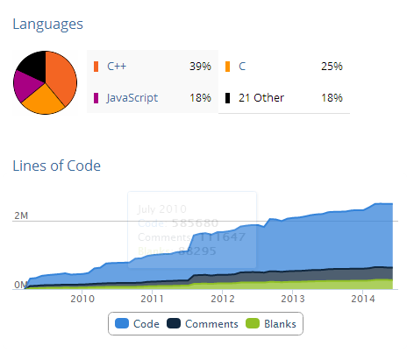
Node.js Project on www.ohloh.net

Slide 48
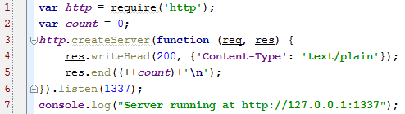
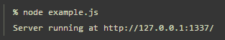
Node.js Server (2009)

Slide 49
Why NodeJS
NodeJS is ideal for Web applications with high volumes of concurrent network requests and heavy I/O
NodeJS can handle millions of concurrent requests on a single process
NodeJS is single threaded, but can run multiple code paths in parallel (POSIC Async Threads ??) because of Events (callbacks)

Slide 50
Appreciating NodeJS
NodeJS is Non-Blocking:
Web applications sending I/O requests (DB call, HTTP call) have to wait around for the request to be resolved
Many languages will be blocked until the web request arrives and the entire app is stalled – threads can handle this but at an expense
NodeJS can handle millions of requests without blocking with its Event Architecture to handle Concurrency

Slide 51
Appreciating NodeJS
NodeJS Modules and NPM:
Sharing code in JavaScript has been a pain up until NodeJS
NodeJS has NPM – Node Package Manager
NPM is included in all NodeJS instals
Similar to Python’s pip, Ruby’s bundler or Java’s Maven
NPM takes all the best bits from all of them!
Installing a package is easy:
npm install package
var package = require(‘package’)
NPM rules!

Slide 52
Node.js Ecosystem
Modules
(CommonJS Securable Module)
 Think Modular, not Monolithic
 Fine grained pieces of logic

Slide 53

innovation through modularity
npm
module (package) manager, taking care of recursive dependencies and resolving collisions, …
Publishing a node module fulﬁlls satisfaction for developers much greater than contributing to a larger code base

Slide 54
Appreciating NodeJS
JavaScript:
One thread == One call stack == One thing at a time
Synchronous functions -> Blocking
Asynchronous functions -> Non-Blocking

Slide 55

First Some Concepts
Notes:
Use a section header for each of the topics, so there is a clear transition to the audience.

Slide 56

First Some Concepts
Notes:
Use a section header for each of the topics, so there is a clear transition to the audience.

Slide 57
Concurrency
All the languages initially were procedural.
(8 * 6 ) / (173 / 5) + 10
So procedurally it should run as :
((8 * 6 ) / (173 / 5))+ 10 and not ((8 * 6 ) / (173 / 5))+ 10)
Early computers were typically single processors and hence each instruction blocked the execution.
Not any more.
If looked closely can we break the previous calculation in concurrent blocks ?
If it can be broken, can the results be used in the correctly ordered computations finally.
If the answer is yes, we can definitely distribute the calculation across multiple processors/ worker threads to do the calculations independently and submit the result.
Parallelism, is it ? Concurrency, is it? Are they same ?
Rob Pike, co-inventor of Google's Go programming language, defines concurrency in this way:
"Concurrency is a way to structure a thing so that you can, maybe, use parallelism to do a better job. But parallelism is not the goal of concurrency; concurrency's goal is a good structure."
Notes:
Concurrency is not parallelism.
A system demonstrating concurrency allows developers to compose applications as if multiple independent processes are simultaneously executing many possibly related things.
Successful high-concurrency application development frameworks provide an easy-to-reason-about vocabulary to describe and build such a system.
Node's design suggests that achieving its primary goal—to provide an easy way to build scalable network programs—includes simplifying how the execution order of coexisting processes is structured and composed. Node helps a developer reasoning about a program, within which many things are happening at once (such as serving many concurrent clients), to better organize his or her code.
Let's take a look at the differences between parallelism and concurrency, threads and processes, and the special way that Node absorbs the best parts of each into its own unique design.

Slide 58
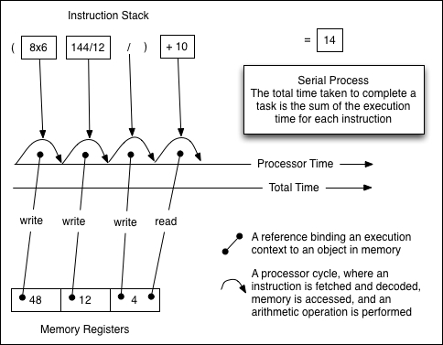
single thread of execution single thread of execution
Notes:
The following diagram describes how a traditional microprocessor might execute the simple program discussed previously:
The program is broken up into individual instructions that are executed in order.
This works but does require that instructions be processed in a serial fashion, and, while any one instruction is being processed, subsequent instructions must wait.
This is a blocking process—executing any one segment of this chain blocks the execution of subsequent segments.
There is a single thread of execution in play.
However, there is some good news. The processor has (literally) total control of the board, and there is no danger of another processor nulling memory or overriding any other state that this primary processor might manipulate. Speed is sacrificed for stability and safety.
We do like speed; however, the model discussed earlier rapidly became obsolete as chip designers and systems programmers worked to introduce parallel computing. Rather than having one blocking thread, the goal was to have multiple cooperating threads.

Slide 59
PROs:
Total control of the execution.
Simple.
No memory management, no state management.
Cons:
Slow.
Blocking.
Cannot leverage parallel computing
But since we do like speed :
The model discussed earlier rapidly became obsolete as chip designers and systems programmers worked to introduce parallel computing.
The GOAL:
Rather than having one blocking thread, the goal was to have multiple cooperating threads.
Notes:
We do like speed;
however, the model discussed earlier rapidly became obsolete as chip designers and systems programmers worked to introduce parallel computing.
Rather than having one blocking thread, the goal was to have multiple cooperating threads.

Slide 60
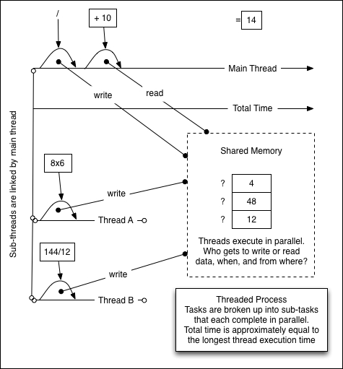
Notes:
This diagram illustrates cooperating threads executing in parallel within a single process,
which reduces the time necessary to perform the given calculation.
Distinct threads are employed to break apart, solve, and compose a solution.
As many subtasks can be completed independently, the overall completion time can be reduced dramatically.
Threads provide parallelism within a single process.
A single thread represents a single sequence of (serially executed) instructions.
A process can contain any number of threads.
Difficulties arise out of the complexity of thread synchronization.
It is very difficult to model highly concurrent scenarios using threads, especially models in which the state is shared.
It is difficult to anticipate all the ways in which an action taken in one thread will affect all the others if it is never clear when an asynchronously executing thread will complete.

Slide 61
PROs:
Problem broken into various atomic concurrent blocks.
Can be run in parallel by various threads.
Overall processing time reduced dramatically.
Cons: *
When the threads are sharing the memory, the system becomes inherently complex.
Communication between the threads become very complex.
Race Conditions and Deadlocks.
Code Reuse or Library sharing can be treacherous.
Rule of Simplicity :
Developers should design for simplicity by looking for ways to break up program systems into small, straightforward cooperating pieces. This rule aims to discourage developers' affection for writing 'intricate and beautiful complexities' that are, in reality, bug-prone programs.
Notes:
Cons :
“The shared memory and the locking behavior this requires lead to systems that are very difficult to reason about as they grow in complexity.”
“Communication between tasks requires the implementation of a wide range of synchronization primitives, such as mutexes and semaphores, condition variables, and so on.
An already challenging environment requires highly complex tools, expanding the level of expertise necessary to complete even relatively simple systems.”
“Race conditions and deadlocks are a common pitfall in these sorts of systems.
Contemporaneous read/write operations within a shared program space lead to problems of sequencing, where two threads may be in an unpredictable race for the right to influence a state, event, or other key system characteristic.”
“Because maintaining dependable boundaries between threads and their states is so difficult, ensuring that a library (for Node, it would be a package or module) is thread safe occupies a great deal of the developer's time.
Can I know that this library will not destroy some part of my application? Guaranteeing thread safety requires great diligence on the part of a library's developer, and these guarantees may be conditional: for example, a library may be thread safe when reading—but not when writing.
After Cons:
Conclusion:
Obviously we want the power of parallelism provided by the threads, but do we want to deal with the mind bending world of semaphores and mutexes, well… not so much.
“Threads offer hyper-efficient parallelism, but make concurrency difficult to reason about.”

Slide 62
Node’s Approach to concurrency. *
Developer not responsible to manage the complexity surrounding the thread management.
Node manages the IO threads.
Developer only designs an application providing the callbacks to be executed when the data becomes available.
Developer is isolated from the complexity, only providing the execution chain.
Notes:
Prologue:
As we have seen : “Parallelism within a single process is a complicated illusion that is achieved deep within mind-bendingly complex chipsets and other hardware.
The question is really about appearances—about how the activity of the system appears to, and can be programmed by, a developer. Threads offer hyper-efficient parallelism, but make concurrency difficult to reason about.”
End:
“How the I/O is run in the background is not of our concern, but due to the way our computer hardware works, with the thread as the basic unit of the processor, libuv and OSes will usually run background/worker threads and/or polling to perform tasks in a non-blocking manner.”

Slide 63
Node is Evented
fileNames = ['a','b','c']
while(filename = fileNames.shift()) {
fileContents = File.read(filename)
print fileContents
}
// > a
// > b
// > c
Notes:
Synchronous Model:
The following iterator will read one file at a time, dump its contents, and then read the next until it is done:”
“This is a fine model for many cases. However, what if these files are very large?
If each takes 1 second to fetch, all will take 3 seconds to fetch. The retrieval on one file is always waiting on another retrieval to finish, which is inefficient and slow.”

Slide 64
“var fs = require('fs');
var fileNames = ['a','b','c'];
fileNames.forEach(function(filename) {
fs.readFile(filename, {encoding:'utf8'}, function(err, content) {
console.log(content);
});
});
// > b
// > a
// > c”
Notes:
“The Node version will read all three files at once, each call to fs.readFile returning its result at some unknowable point in the future.
This is why we can't always expect the files to be returned in the order they were arrayed.
We can expect that all three will be returned in roughly the time it took for one to be retrieved—something less than 3 seconds.
We have traded a predictable execution order for speed, and, as with threads, achieving synchronization in concurrent environments requires extra work.
How do we manage and describe unpredictable data events so that our code is both easy to understand and efficient?”
“The key design choice made by Node's designers was the implementation of an event loop as a concurrency manager.”

Slide 65
Excerpt from :
http://www.princeton.edu/~achaney/tmve/wiki100k/docs/Event-driven_programming.html
“In computer programming, event-driven programming or event-based programming is a programming paradigm in which the flow of the program is determined by events—that is, sensor outputs or user actions (mouse clicks, key presses) or messages from other programs or threads.
Event-driven programming can also be defined as an application architecture technique in which the application has a main loop that is clearly divided down to two sections: the first is event selection (or event detection), and the second is event handling […]
Event-driven programs can be written in any language although the task is easier in languages that provide high-level abstractions, such as closures.”
Notes:
“As we've seen in the preceding quote, single-threaded execution environments block and can, therefore, run slowly. V8 provides a single thread of execution for JavaScript programs.
How can this single thread be made more efficient?
Node makes a single thread more efficient by delegating many blocking operations to OS subsystems to process, bothering the main V8 thread only when there is data available for use.
The main thread (your executing Node program) expresses interest in some data (such as via fs.readFile) by passing a callback and is notified when that data is available.
Until that data arrives, no further burden is placed on V8's main JavaScript thread.”
“How? Node delegates I/O work to libuv”

Slide 66
http://nikhilm.github.io/uvbook/basics.html#event-loops:
“In event-driven programming, an application expresses interest in certain events and responds to them when they occur. The responsibility of gathering events from the operating system or monitoring other sources of events is handled by libuv, and the user can register callbacks to be invoked when an event occurs.”
Notes:
“The user in the preceding quote is the Node process executing a JavaScript program.
Callbacks are JavaScript functions, and managing callback invocation for the user is accomplished by Node's event loop.
Node manages a queue of I/O requests populated by libuv, which is responsible for polling the OS for I/O data events and handing off the results to JavaScript callbacks.

Slide 67
Consider the following code :
var fs = require('fs');
fs.readFile('foo.js', {encoding:'utf8'}, function(err, fileContents) {
console.log('Then the contents are available', fileContents);
});
console.log('This happens first');”
Output :
“> This happens first
> Then the contents are available, [file contents shown]”

Slide 68
Node loads the fs module.
This provides access to fs.binding, which is a static type map defined in src/node.cc that provides glue between C++ and JS code. (https://groups.google.com/forum/#!msg/nodejs/R5fDzBr0eEk/lrCKaJX_6vIJ).
The fs.readFile method is passed instructions and a JavaScript callback. Through fs.binding, libuv is notified of the file read request and is passed a specially prepared version of the callback sent by the original program.
libuv invokes the OS-level functions necessary to read a file within its own thread pool.
The JavaScript program continues, printing This happens first. Because there is a callback outstanding, the event loop continues to spin, waiting for that callback to resolve.
When the file descriptor has been fully read by the OS, libuv (via internal mechanisms) is informed and the callback passed to libuv is invoked, which essentially prepares the original JavaScript callback for re-entrance into the main (V8) thread.
The original JavaScript callback is pushed onto the event loop queue and is invoked on the next tick of the loop.
The file contents are printed to the console.
As there are no further callbacks in flight, the process exits.”
Notes:
“Here, we see the key ideas that Node implements to achieve fast, manageable, and scalable I/O.
If, for example, there were 10 read calls made for 'foo.js' in the preceding program, the execution time would, nevertheless, remain roughly the same.
Each call would have been made in parallel in its own thread within the libuv thread pool. Even though we wrote our code "in JavaScript", we are actually deploying a very efficient multithreaded. execution engine while avoiding the difficulties of thread management.
Let's close with more details on how exactly libuv results are returned into the main thread's event loop.
When data becomes available on a socket or other stream interface, we cannot simply execute our callback immediately.
JavaScript is single threaded, so results must be synchronized.
We can't suddenly change the state in the middle of an event loop tick—this would create some of the classic multithreaded application problems of race conditions, memory access conflicts, and so on.
Upon entering an event loop, Node (in effect) makes a copy of the current instruction queue (also known as stack), empties the original queue, and executes its copy.
The processing of this instruction queue is referred to as a tick. If libuv, asynchronously, receives results while the chain of instructions copied at the start of this tick are being processed on the single main thread (V8), these results (wrapped as callbacks) are queued.
Once the current queue is emptied and its last instruction has completed, the queue is again checked for instructions to execute on the next tick. This pattern of checking and executing the queue will repeat (loop) until the queue is emptied, and no further data events are expected, at which point the Node process exits.”

Slide 69
The following are the types of events that can be queued:
Execution blocks:
Timers:
I/O:
Deferred execution blocks:
Notes:
These are blocks of JavaScript code comprising the Node program; they could be expressions, loops, functions, and so on. This includes EventEmitter events emitted within the current execution context.
These are callbacks deferred to a time in the future specified in milliseconds, such as setTimeout and setInterval.
These are prepared callbacks returned to the main thread after being delegated to Node's managed thread pool, such as filesystem calls and network listeners.
These are mainly the functions slotted on the stack according to the rules of setImmediate and process.nextTick.”

Slide 70
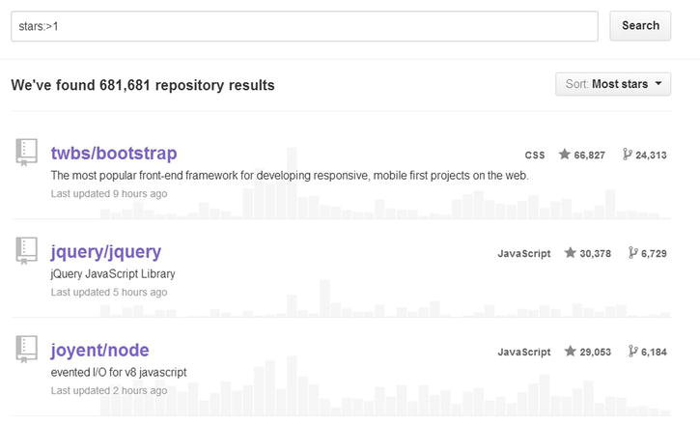
Little JavaScript Primer
Now that we understand the motivation for using Node.js, let’s delve further into JavaScript so that we can write maintainable applications. In addition to the fact that you need to be good at JavaScript if you want to become a Node.js developer, another reason to be good at JavaScript is to take advantage of the thriving ecosystem around Node.js and JavaScript in general. The language with the greatest number of projects on GitHub is JavaScript. Node.js is the most popular server-side technology on GitHub, as shown in Figure below.

Slide 71
Variables:
Variables are defined in JavaScript using the var keyword. Refer variable.js
The JavaScript runtime (the browser or Node.js) has the opportunity to define a few global variables that we can use in our code. One of them is the console object, which we have been using up to this point. The console object contains a member function (log), which takes any number of arguments and prints them to the console. We will discuss more global objects as they are used. As you will see, JavaScript contains most things you expect a good programming language to have.
Numbers:
All numbers in JavaScript have the same floating point number type. Arithmetic operations (+,-,*,/,%) work on numbers as you would expect [Refer to numbers.js].
Boolean:
Two literals are defined for boolean values: true and false. You can assign these to variables and apply boolean operations to them as you would expect. [Refer to boolean.js].
Arrays:
You can create arrays quite easily in JavaScript using []. Refre to arrays.js.
Object Literals:
By explaining these few fundamental types, we have introduced you to object literals. The most common way of creating an object in JavaScript is using the object notation, {}. Objects can be extended arbitrarily at runtime. Refer to object directory.

Slide 72
Functions:
First class objects. You can pass a function to another function as argument, a function can even return a function as a value.
A programming language is said to have first-class functions if a function can be treated the same way as any other variable in the language. JavaScript has first-class functions.
Not traditional- The functions in JS do not behave as they do in any other language.
All functions return a value in JavaScript. In the absence of an explicit return statement, a function returns undefined.
You can execute a function immediately after you define it. Simply wrap the function in parentheses () and invoke it.
The only recommended way of creating a new variable scope in JavaScript is using a function. So, in order to create a new variable scope, we can use an immediately executing function.
A function without a name is called an anonymous function.
In JavaScript, you can assign a function to a variable. If you are going to use a function as a variable, you don’t need to name the function.
Higher-Order Functions: Since JavaScript allows us to assign functions to variables, we can pass functions to other functions. Functions that take functions as arguments are called higher-order functions.

Slide 73
Closures:
Whenever we have a function defined inside another function, the inner function has access to the variables declared in the outer function. Closures are best explained with examples.
The inner function has access to a variable (variableInOuterFunction) from the outer scope. The variables in the outer function have been closed by (or bound in) the inner function. Hence the term closure. The concept in itself is simple enough and fairly intuitive.
The inner function can access the variables from the outer scope even after the outer function has returned. This is because the variables are still bound in the inner function and not dependent on the outer function.

Slide 74
Some more fundamentals:
Everything Is a Reference.
The default value of any variable in JavaScript is undefined.
Exact Equality : One thing to be careful about in JavaScript is the difference between == and ===. As JavaScript tries to be resilient against programming errors, == tries to do type coercion between two variables.
Null: null is a special JavaScript object used to denote an empty object. This is different from undefined, which is used by JavaScript for nonexistent and noninitialized values. You should not set anything to undefined because, by convention, undefined is the default value you should leave to the runtime. A good time to use null is when you want to explicitly say that something is not there, such as as a function argument.
Truthy and Falsy: One important concept in JavaScript is truthy values and falsy values. Truthy values are those that behave like true in boolean operations and falsy values are those that behave like false in boolean operations. It is generally easier to use if / else / ! for null / undefined instead of doing an explicit check.
Module Pattern: Functions that return objects are a great way to create similar objects. An object here means data and functionality bundled into a nice package, which is the most basic form of Object Oriented Programming (OOP) that one can do. At the heart of the revealing module pattern is JavaScript’s support for closures and ability to return arbitrary (function + data) object literals.

Slide 75
Recalling this:
Special keyword that references the context.
If an function is called from a global context, this refers to the Node.js global variable.[this2.js]
Recall the funda of first-class functions where we can change the context of the function at anytime[this3.js].
If youuse the function as the constructor function then the this inside points to the newly created object.[this4.js].
Recalling Prototype:
Prototype is a secret property of a constructor function which points to an empty object.
It is the corner stone of the Object orientation in JS which does not have a concept of classes.
So when we try to access a property on a an object that it does not have as its own property, it would try to loop through the prototype properties to see if its there.[prototype2.js]
Prototypes are a live reference shared by all the instances of the constructor functions.[prototype3.js]
All the functionality you put on prototype is shared. And therefore lesson one:prototype saves memory.
But of the instance has a property of its own then the prototype property would be eclipsed. [prototype4.js]
.prototype is not good for properties you plan on writing to. For the properties you plan to write on, you should use the this
But the properties that you reckon would not be altered should find their place on the prototype. An example of sunch property is a function. That brings us to the concept class.js.

Slide 76
Recalling Error handling:
Important part of any application.
We have a great Exception Handling mechanism in JS. Analogous to the other language, to throw an exception, you simply use the throw JavaScript keyword.
To catch an exception, you can use the catch keyword.
For the code which you think should run regardless of any exception, you should place that under the finally block.[error1.js]
One interesting behavior is when we are dealing with asynchronous callbacks.[error2.js]
Another interesting problem is to let the callbacks know that there was an error. This is well explained by the following example. Error3.js.

Slide 77
Installation and verification: Node
Let us visit: https://nodejs.org/
For Mac it is most advisable to install it using the Home Brew: http://brew.sh/
ruby -e "$(curl -fsSL https://raw.githubusercontent.com/Homebrew/install/master/install)"
For windows you can follow this blog post “
http://blog.teamtreehouse.com/install-node-js-npm-windows
When you install node following are the executable files and the folders that you would see under the installed location:
Node: “ This file starts a Node.js JavaScript engine. If you pass in a JavaScript file location, Node.js executes that script. If no target JavaScript file is specified, a script prompt allows you to execute JavaScript code directly from the console.”
npm: You use this command to manage the Node.js packages, as discussed in the next section.
node_modules: This folder contains the installed Node.js packages. These packages act as libraries that extend the capabilities of Node.js.
To verify the installation:
node –version
npm version

Slide 78
Installation and verification: MongoDB
You can install MongoDB with Homebrew or manually. This section describes both.
Install MongoDB with Homebrew
1 Update Homebrew’s package database.
In a system shell, issue the following command:
brew update
2 Install MongoDB.
You can install MongoDB via brew with several different options. Use one of the following operations:
Install the MongoDB Binaries : To install the MongoDB binaries, issue the following command in a system shell:
brew install mongodb
Install the Latest Development Release of MongoDB : To install the latest development release for use in testing and development, issue the following command in a system shell:
brew install mongodb --devel

Slide 79
Node is Modular
Node has a great ecosystem.
Very clean deployment.
Any extension needed is coded and installed as an Node Packaged Manager.
NPMs can be installed and de-installed at any point of time.
Since it is a fundamental concept we would spend some time with the NODE NPMs viz (Node Packaged Modules and the Node Package Managers).
A Node Packaged Module is a packaged library that can easily be shared, reused, and installed in different projects. There are many different modules available for a variety of purposes. For example, the Mongoose module provides an ODM for MongoDB, Express extends Node’s HTTP capabilities, and so on.
Node.js modules are created by various third-party organizations to provide important features that Node.js lacks out of the box. This community of contributors is very active in adding and updating modules.
Each Node Packaged Module includes a package.json file that defines the packages. The package.json file includes informational metadata such as the name, version, author, and contributors, as well as control metadata such as dependencies and other requirements that the Node Package Manager will use when performing actions such as installation and publishing.

Slide 80
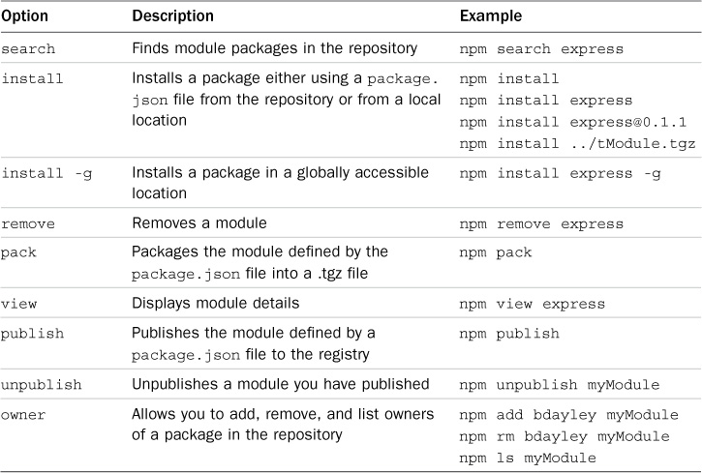
Node Packaged Registry
Managed Location to register all the NPMs.
URL: http://npmjs.org
Going there, one can view the most popular, latest as well as specific modules.

Slide 81
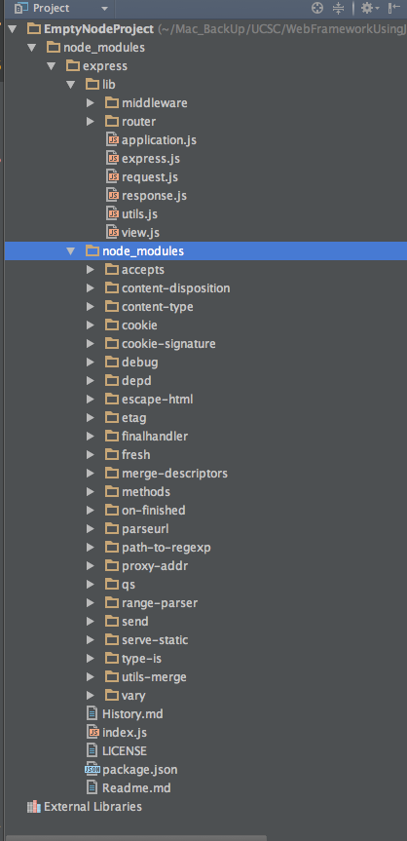
Searching and Installing the NPMs
One can search the NPMs by the simple command :
npm search <serach_string>
To use a Node module in your applications, it must first be installed where Node can find it.
To install a Node module, use the :
npm install <module_name> command to download the Node module to your development environment and place it in the node_modules folder, where the install command is run.
For example, the following command installs the express module:
npm install express
The output of the npm install command displays the HTTP requests to download the necessary files as well as the dependency hierarchy that was installed with the module.
At this point let us just create an empty project and name it EmptyNodeProject.
Once there in the webstorm open the terminal and fire
npm install express
express requires the methods, cookie-signature, range-parser, debug, buffer-crc32, fresh, cookie, mkdirp, commander, send, and connect modules.
Node.js has to be able to handle dependency conflicts. For example, the express module requires cookie 0.1.0, but another module may require cookie 0.0.9. To handle this situation, a separate copy for the cookie module is placed in each module’s folder, under another node_modules folder.

Slide 82
Using Package.json
A simple JSON text file that defines a module, including dependencies in the root file.
All NPMs must have it.
Can contain a number of different directives to tell the Node Package Manager how to handle the module.
Sample package.json:
{
"name": "my_module",
"version": "0.1.0",
"description": "a simple node.js module",
"dependencies" : {
"express" : "latest"
}
}
The only required directives in the package.json file are name and version; the rest depend on what you would like to include.
A great way to use package.json files is to automatically download and install the dependencies for your Node.js app. All you need to do is create a package.json file in the root of your project code and add the necessary dependencies to it. For example, the following package.json file requires the express module as a dependency:
{
"name": "my_module",
"version": "0.1.0",
"dependencies" : {
"express" : "latest"
}
}
Now let us delete the previously added express package in our empty project and add the package.json in the project and then run the command:
npm install
Notice that no module is specified in the command npm install. That is because npm looks for a package.json file by default. Later, as you need additional modules, all you need to do is add those to the dependencies directive and then run npm install again.

Slide 83
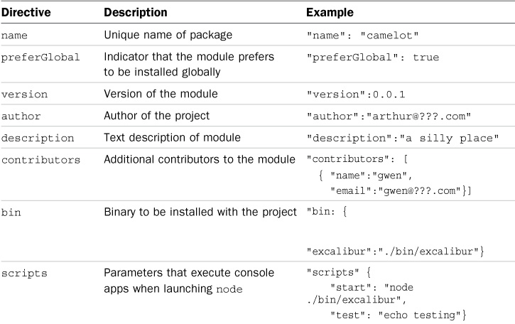
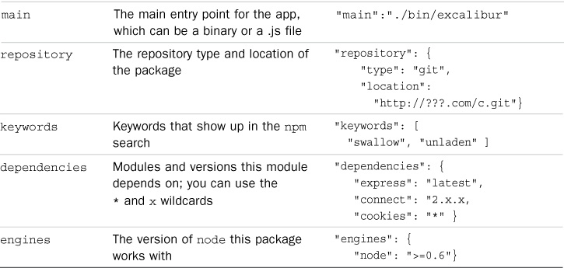

Slide 84
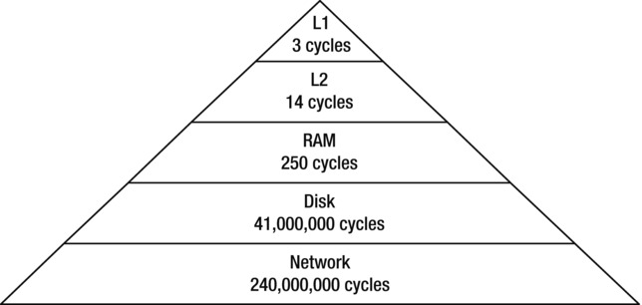
Understanding Node.js Performance
Node.js is focused on being the best way to write highly performant web applications. To understand how it achieves this, we need to know about the I/O scaling problem. Let us look at a rough estimate of the speed at which we can access data from various sources in terms of CPU cycles
You can clearly see that Disk and Network access is in a completely different category from accessing data that is available in RAM and CPU cache.
Most web applications depend on reading data from disk or from another network source (for example, a database query). When an HTTP request is received and we need to load data from a database, typically this request will be spent waiting for a disk read or a network access call to complete.
These open connections and pending requests consume server resources (memory and CPU). In order to handle a large number of requests from different clients using the same web server, we have the I/O scaling problem.

Slide 85
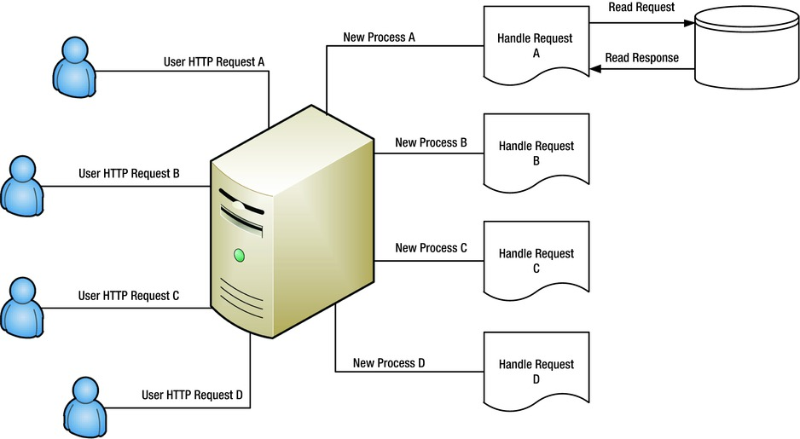
Traditional servers used to spin up a new process to handle every single web request. Spinning a new process for each request is an expensive operation, both in terms of CPU and memory. This is the way technologies like PHP used to work when they were first created.
In order to successfully reply to an HTTP request “A,” we need some data from a database.
This read can potentially take a long time. For this entire read duration, we will have a process taking up CPU and memory while idling and waiting for the database response. Also, processes are slow to start and have a significant overhead in terms of RAM space. This does not scale for very long and that is the reason why modern web applications use a thread pool.

Slide 86
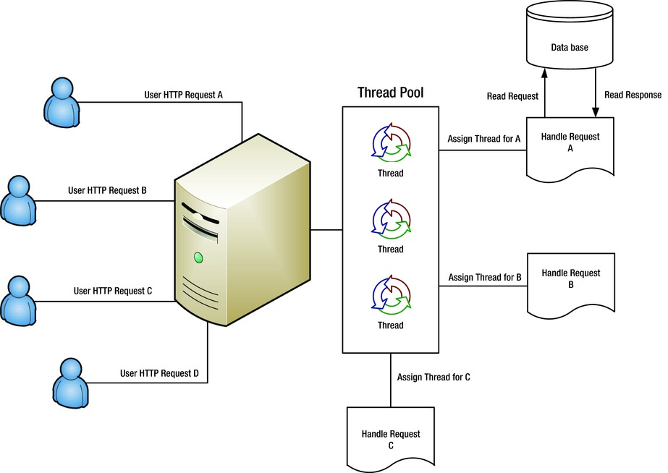
Modern servers use a thread from a thread pool to serve each request. Since we already have a few Operating System (OS) threads created (hence a thread pool), we do not pay the penalty of starting and stopping OS processes (which are expensive to create and take up much more memory than a thread). When a request comes in, we assign a thread to process this request. This thread is reserved for the request in the entire duration that the request is being handled.
Because we save the overhead of creating a new process every time and the threads are lighter than processes, this method is much better than the original server design. Most web servers used this method a few years back and many continue to use today. However, this method is not without drawbacks. Again there is wasting of RAM between threads. Also the OS needs to context switch between threads (even when they are idle), and this results in wasted CPU resources.

Slide 87
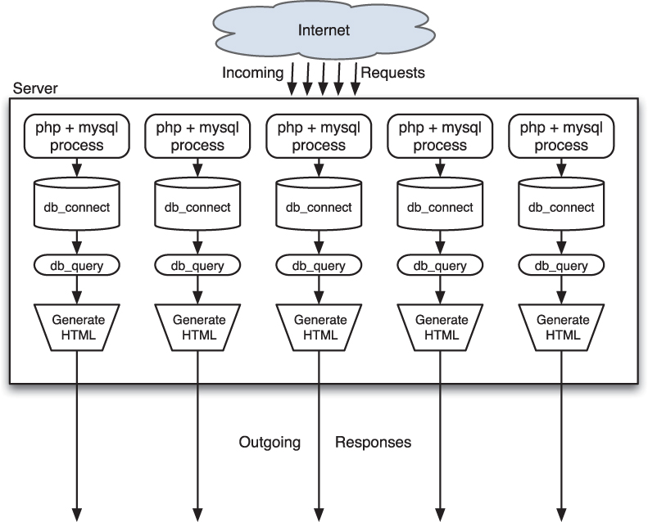
In the olden days (2008 or so), assume you’re using something vaguely PHP-ish) for example purposes:
$file = fopen('info.txt', 'r');
// wait until file is open
$contents = fread($file, 100000);
// wait until contents are read
// do something with those contents
it spends a vast majority of its time doing nothing at all. Indeed, most of the clock time taken by this script is spent waiting for the computer’s file system to do its job and return the file contents you requested.
And that is indeed the story of most most IO Based applications.

Slide 88
The way your server computers process multiple requests at the same time is by running many of these scripts in parallel. Modern computer operating systems are great at multitasking, so you can easily switch out processes that are blocked and let other processes have access to the CPU. Some environments take things a step further and use threads instead of processes.
The problem is that for each of these processes or threads is that there is some amount of overhead.
For heavier implementations using Apache and PHP it might be 10–15MB per-process memory overhead in the past—never mind the resources and time consumed by the operating system switching that context in and out constantly. That’s not even 100 simultaneously executing servers per gigabyte of RAM!
Threaded solutions and those using more lightweight HTTP servers do, of course, have better results, but you still end up in a situation in which the computer spends most of its time waiting around for blocked processes to get their results, and you risk running out of capacity to handle incoming requests.
It would be nice if there were some way to make better use of all the available CPU computing power and available memory so as not to waste so much. This is where Node.js shines.

Slide 89
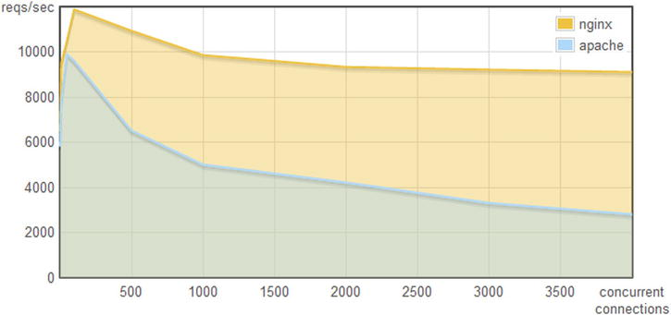
The Nginx Way
We have seen that creating separate processes and separate threads to handle requests results in wasted OS resources. The way Node.js works is that there is a single thread handling requests. The idea that a single threaded server can perform better than a thread pool server is not new to Node.js. Nginx is built on this principle.
Nginx is a single-threaded web server and can handle a tremendous amount of concurrent requests. A simple benchmark comparing Nginx to Apache, both serving a single static file from the file system
As you can see, when the number of concurrent connections goes up.

Slide 90
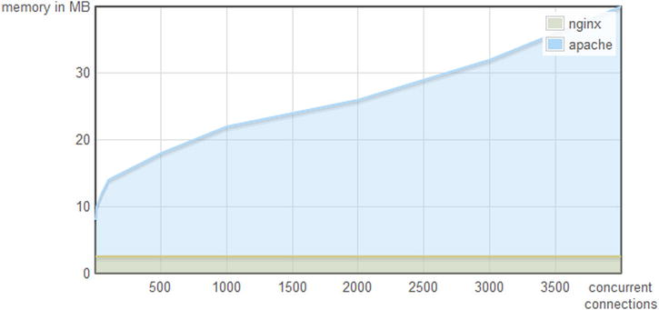
Nginx can handle a lot more requests per second than Apache. What is more interesting is the memory consumption
With more concurrent connections, Apache needs to manage more threads and therefore consumes much more memory, whereas Nginx stays at a steady level

Slide 91
The Node.js Way of Doing Things
I hope you recall our old buddy: setTimeOut.
NodeJS/Tutorial_1/Node_JS_AsynchronousWay/Basics_setTimeOut_.js
Now let us rewrite the code in previous example using this new approach.
NodeJS/Tutorial_1/Node_JS_AsynchronousWay/Basics_NodeWayOfOpeningFile.js
NodeJS/Tutorial_1/Node_JS_AsynchronousWay/Basics_NodeWayOfOpeningFile_Corrected.js
The key way to think of how these asynchronous functions work is something along the following lines:
Check and validate parameters.
Tell the Node.js core to queue the call to the appropriate function for you (in the preceding example, the operating system open or the read function), and to notify (call) the provided callback function when there is a result.
Return to the caller.
You might be asking: If the open function returns right away, why doesn’t the node process exit immediately after that function has returned? The answer is that Node operates with an event queue; if there are pending events for which you are awaiting a response, it does not exit until your code has finished executing and there are no events left on that queue. If you are waiting for a response (either to the open or the read function calls), it waits.

Slide 92
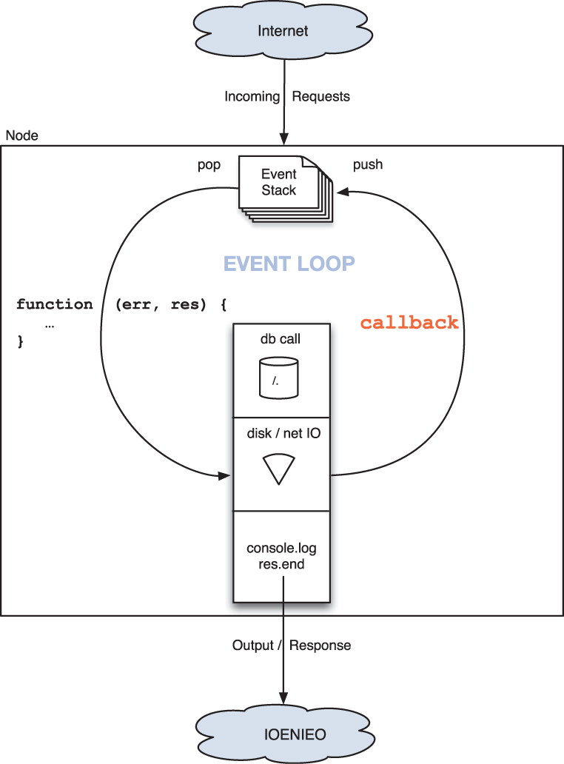
As long as there is code executing or somebody is waiting for something, Node runs.

Slide 93
Node.js Performance Secret
There is a single execution thread in JavaScript. This is the way web browsers have traditionally worked. If you have a long-running operation (such as waiting for a timer to complete or a database query to return), you must continue operation using a callback.
function longRunningOperation(callback) {
// simulate a 3 second operation
setTimeout(callback, 3000);
}
function userClicked() {
console.log('starting a long operation');
longRunningOperation(function () {
console.log('ending a long operation');
});
}
// simulate a user action
userClicked();
The code above provides a simple demo that uses the JavaScript runtime setTimeout function to simulate a long-running operation. You can run this code using Node.js.
This simulation is possible in JavaScript because we have first-class functions and passing functions—a callback is a well-supported pattern in the language. Things become interesting when you combine first-class functions with the concept of closures.

Slide 94
Let us image that we are handling a web request and we have a long-running operation such as a database query that we need to do. A simulated version is shown below:
function longRunningOperation(callback) {
// simulate a 3 second operation
setTimeout(callback, 3000);
}
function webRequest(request) {
console.log('starting a long operation for request:', request.id);
longRunningOperation(function () {
console.log('ending a long operation for request:', request.id);
});
}
// simulate a web request
webRequest({ id: 1 });
// simulate a second web request
webRequest({ id: 2 });
In the example above, because of closures, we have access to the correct user request after the long-running operation completes. We just handled two requests on a single thread without breaking a sweat. Now you should understand the following statement: “Node.js is highly performant, and it uses JavaScript because JavaScript supports first-class functions and closures.”
The immediate question that should come to mind when someone tells you that you only have a single thread to handle requests is, “But my computer has a quad core CPU. Using only a single thread will surely waste resources.” And the answer is that yes it will. However, there is a well-supported way around it that we will examine in one of our future sessions when discussing deployment and scalability. Just a quick tip about what you will see there: It is actually really simple to use all the CPU cores with a separate JavaScript process for each CPU core using Node.js.
It is also important to note that there are threads managed by Node.js at the C level (such as for certain file system operations), but all the JavaScript executes in a single thread. This gives you the performance advantage of the JavaScript almost completely owning at least one thread.

Slide 95
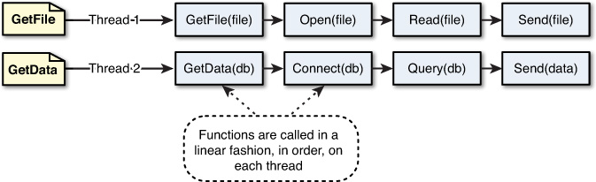
Comparing the Event Callbacks and Threaded Model
In the traditional threaded web model, a request comes to a webserver and is assigned to an available thread. The handling of work for that request continues on that thread until the request is complete and a response is sent.
The following diagram illustrates the threaded model processing two requests, GetFile and GetData. The GetFile request opens the file, reads the contents, and then sends the data back in a response. All this occurs in order on the same thread. The GetData request connects to the database, queries the necessary data, and then sends the data in the response.
Now think about how the Node.js event model does things. Instead of executing all the work for each request on individual threads, Node.js adds work to an event queue and then has a single thread running an event loop pick it up. The event loop grabs the top item in the event queue, executes it, and then grabs the next item. When executing code that is longer lived or has blocking I/O, instead of calling the function directly, it adds the function to the event queue along with a callback that will be executed after the function completes. When all events on the Node.js event queue have been executed, the Node.js application terminates.

Slide 96
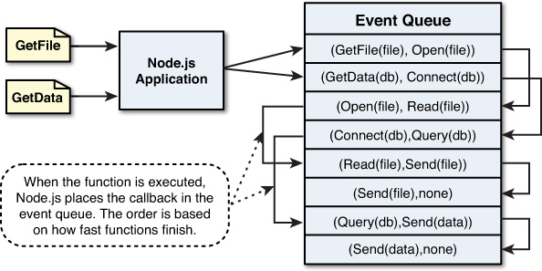
The figure below how Node.js handles the GetFile and GetData requests. It adds the GetFile and GetData requests to the event queue. It first picks up the GetFile request, executes it, and completes by adding the Open() callback function to the event queue. Then it picks up the GetData request, executes it, and completes by adding the Connect() callback function to the event queue. This continues until there are no callback functions to be executed. Notice in Figure 4.2 that the events for each thread don’t necessarily follow a direct interleaved order. For example, the Connect request takes longer to complete than does the Read request, so Send(file) is called before Query(db).

Slide 97
Blocking I/O in Node.js
The Node.js event model of using event callbacks is great until you run into the problem of functions that block on I/O. Blocking I/O stops the execution of the current thread and waits for a response before continuing. Some examples of blocking I/O are:
Reading a file
Querying a database
Requesting a socket
Accessing a remote service
Node.js uses event callbacks to avoid having to wait for blocking I/O. Therefore, any requests that perform blocking I/O are performed on a different thread in the background. Node.js implements a thread pool in the background. When an event that blocks I/O is retrieved from the event queue, Node.js retrieves a thread from the thread pool and executes the function there instead of on the main event loop thread. This prevents the blocking I/O from holding up the rest of the events in the event queue.
The function that is executed on the blocking thread can still add events back to the event queue to be processed. For example, a database query call is typically passed a callback function that parses the results and may schedule additional work on the event queue before sending a response.

Slide 98
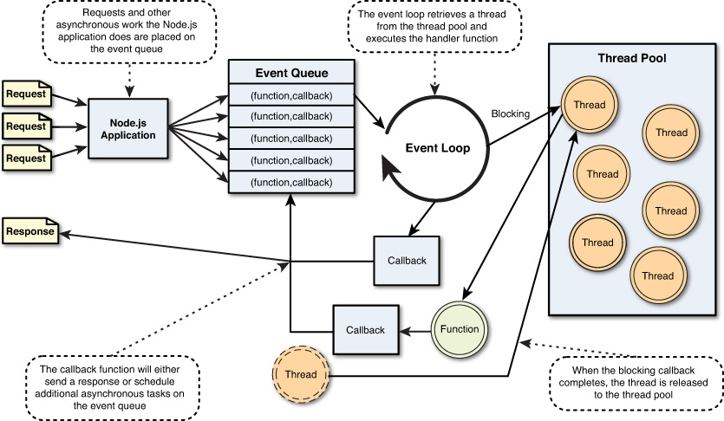
The above figure illustrates the full Node.js event model, including the event queue, event loop, and thread pool. Notice that the event loop either executes the function on the event loop thread itself or, for blocking I/O, executes the function on a separate thread.In the Node.js event model work is added as a function with callback to the event queue and then picked up on the event loop thread. The function is then executed on the event loop thread in case of non-blocking or on a separate thread in the case of blocking.

Slide 99
More Node.js Internals
At the heart of Node.js is an event loop.
Event loops enable any GUI application to work on any operating system. The OS calls a function within your application when something happens (for example, the user clicks a button), and then your application executes the logic contained inside this function to completion. Afterward, your application is ready to respond to new events that might have already arrived (and are there on the queue) or that might arrive later (based on user interaction).
Thread Starvation
Generally during the duration of a function called from an event in a GUI application, no other events can be processed. Consequently, if you do a long-running task within something like a click handler, the GUI will become unresponsive. This is something every computer user I have met has experienced at one point or another. This lack of availability of CPU resources is called starvation.

Slide 100
To understand it better, let’s go through a few code examples. Listing below shows a small snippet of code that measures the time passed using console.time and console.timeEnd functions.
console.time('timer');
setTimeout(function(){
console.timeEnd('timer');
},1000)
If you run this code, you should see a number quite close to what you would expect—in other words, 1000ms. This callback for the timeout is called from the Node.js event loop.
Now let’s write some code that takes a long time to execute, for instance, a nonoptimized method of calculating the nth Fibonacci number as shown in:
console.time('timeit');
function fibonacci(n) {
if (n < 2)
return 1;
elses
return fibonacci(n - 2) + fibonacci(n - 1);
}
fibonacci(44); // modify this number based on your system performance
console.timeEnd('timeit'); // On my system it takes about 9000ms (i.e. 9 seconds)
Now we have an event that can be raised from the Node.js event loop (setTimeout) and a function that can keep the JavaScript thread busy (fibonacci). We can now demonstrate starvation in Node.js. Let’s set up a time-out to execute. But before this time-out completes, we execute a function that takes a lot of CPU time and therefore holds up the CPU and the JavaScript thread. As this function is holding on to the JavaScript thread, the event loop cannot call anything else and therefore the time-out is delayed.

Slide 101
// utility funcion
function fibonacci(n) {
if (n < 2)
return 1;
else
return fibonacci(n - 2) + fibonacci(n - 1);
}
// setup the timer
console.time('timer');
setTimeout(function () {
console.timeEnd('timer'); // Prints much more than 1000ms
}, 1000)
// Start the long running operation
fibonacci(44);
One lesson here is that Node.js is not the best option if you have a high CPU task that you need to do on a client request in a multiclient server environment. However, if this is the case, you will be very hard-pressed to find a scalable software solution in any platform. Most high CPU tasks should take place offline and are generally offloaded to a database server using things such as materialized views, map reduce, and so on. Most web applications access the results of these computations over the network, and this is where Node.js shines—evented network I/O.
Now that you understand what an event loop means and the implications of the fact that JavaScript portion of Node.js is single-threaded, let’s take another look at why Node.js is great for I/O applications.

Slide 102
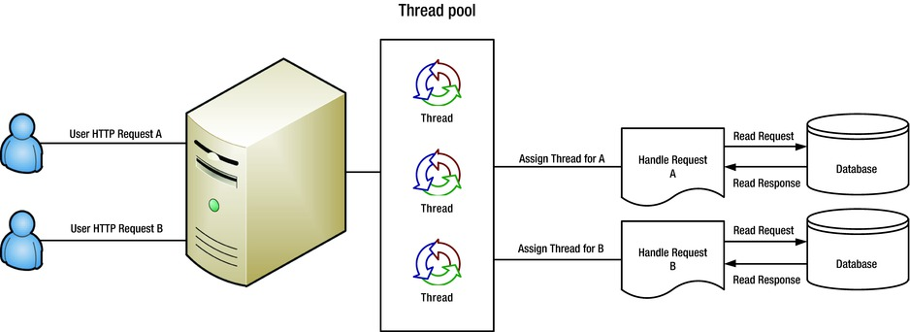
Data-Intensive Applications
Node.js is great for data-intensive applications. As we have seen, using a single thread means that Node.js has an extremely low-memory footprint when used as a web server and can potentially serve a lot more requests. Consider the simple scenario of a data intensive application that serves a dataset from a database to clients via HTTP. We know that gathering the data needed to respond to the client query takes a long time compared to executing code and/or reading data from RAM.

Slide 103
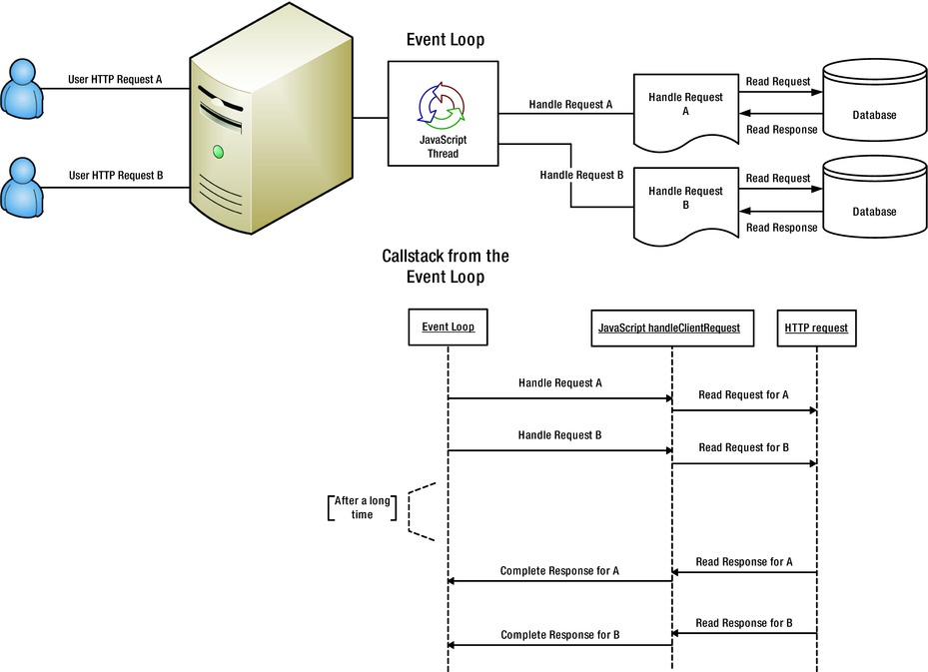
Data-Intensive Applications
The same server in Node.js is shown in Figure 2-7. All the work is going to be inside a single thread, which results in lesser memory consumption and, due to the lack of thread context switching, lesser CPU load. Implementation-wise, the handleClientRequest is a simple function that calls out to the database (using a callback). When that callback returns, it completes the request using the request object it captured with a JavaScript closure.
function handleClientRequest(request) {
makeDbCall(request.someInfo, function (result) {
// The request corresponds to the correct db result because of closure
request.complete(result);
});
}
Note that the HTTP request to the database is also managed by the event loop. The advantage of having async IO and why JavaScript + Node.js is a great fit for data-intensive applications should now be clear.

Slide 104
The V8 JavaScript Engine
It is worth mentioning that all the JavaScript inside Node.js is executed by the V8 JavaScript engine. V8 came into being with the Google Chrome project. V8 is the part of Chrome that runs the JavaScript when you visit a web page.
Anybody who has done any web development knows how amazing Google Chrome has been for the web. The browser usage statistics reflect that quite clearly. According to w3schools.org (www.w3schools.com/browsers/browsers_stats.asp), nearly 56% of Internet users who visit their web site are now using Google Chrome. There are lots of reasons for this, but V8 and its speed is a very important factor. Besides speed, another reason for using V8 is that the Google engineers made it easy to integrate into other projects, and that it is platform independent.

Slide 105


Slide 106
Adding Work to the Event Queue
As you create Node.js applications and design code, you need to keep in mind the event model described in the previous section. To leverage the scalability and performance of the event model, make sure you break up work into chunks that can be performed as a series of callbacks.
When you have designed your code correctly, you can use the event model to schedule work on the event queue. In Node.js applications, you schedule work on the event queue by passing a callback function using one of these methods:
Make a call to one of the blocking I/O library calls, such as writing to a file or connecting to a database.
Add an event listener to a built-in event such as an http.request or server.connection.
Create your own event emitters and add custom listeners to them.
Using the process.nextTick option to schedule work to be picked up on the next cycle of the event loop.
Use timers to schedule work to be done after a particular amount of time or at periodic intervals.

Slide 107
Timers:
One of the uses is to delay execution of code for a period of time.
Can be useful for the cleanup activities.
Three manifestations :
Timeout,
interval, and
immediate timers.
Timeout timers are used to delay work for a specific amount of time. When that time expires, the callback function is executed, and the timer goes away. You should use timeouts for work that needs to be performed only once.
setTimeout(callback, delayMilliSeconds, [args]) method built into Node.js.
When you call setTimeout(), the callback function is executed after delayMilliSeconds has expired. For example, the following executes myFunc() after a second:
setTimeout(myFunc, 1000);
The setTimeout() function returns a timer object ID, and you can pass this ID to clearTimeout(timeoutId) at any time before delayMilliSeconds expires to cancel the timeout function. For example:
myTimeout = setTimeout(myFunc, 100000);
...
clearTimeout(myTimeout);
The code in above implements a series of simple timeouts that call the simpleTimeout() function, which outputs the number of milliseconds since the timeout was scheduled. Notice that it doesn’t matter in which order setTimeout() is called.
Reference : timer_Implementation_1.js

Slide 108
Intervals:
Used to preform the work on a repeatedly on a delayed interval.
Used for the work that has to be performed at regular intervals.
You create interval timers by using the following syntax:
setInterval(callback, delayMilliSeconds, [args])
This method that is built into Node.js. When you call setInterval(), the callback function is executed every interval after delayMilliSeconds has expired. For example, the following executes myCallBack () every second:
setInterval(myCallBack, 1000);
The setInterval() function returns a timer object ID, and you can pass this ID to clearInterval(intervalId) at any time before delayMilliSeconds expires to cancel the timeout function. For example:
myInterval = setInterval(myFunc, 100000);
...
clearInterval(myInterval);
Refernce : interval_Implementation_1.js

Slide 109
Immediate Timer
Used to perform work as soon as the I/O event callbacks begin executing but before any timeout or interval events are executed.
They allow you to schedule work to be done after the current events in the event queue are completed. You should use immediate timers to yield long-running execution segments to other callbacks to prevent starving the I/O events.
setImmediate(myFunc(), 1000);
Function built into Node.js
Callbacks for immediates are queued in the order in which they were created. The entire callback queue is processed every event loop iteration. If you queue an immediate from inside an executing callback, that immediate won't fire until the next event loop iteration.
For example, the following code schedules myFunc() to execute on the next cycle through the event queue:
setImmediate(myFunc(), 1000);
The setImmediate() function returns a timer object ID, and you can pass this ID to clearImmediate(immediateId) at any time before it is picked up from the event queue. For example:
myImmediate = setImmediate(myFunc);
...
clearImmediate(myImmediate);

Slide 110
Dereferencing Timers from the Event Loop
Often you will not want timer event callbacks to continue to be scheduled when they are the only events left in the event queue. Node.js provides a very useful utility to handle this case.
The unref() function, available in the object returned by setInterval and setTimeout, allows you to notify the event loop to not continue when these are the only events on the queue.
For example, the following code dereferences the myInterval interval timer:
Click here to view code image
myInterval = setInterval(myFunc);
myInterval.unref();
If for some reason you later do not want the program to terminate if the interval function is the only event left on the queue, you can use the ref() function to re-reference it:
myInterval.ref();

Slide 111
Error Handling with Asynchronous Functions
try {
setTimeout(function () {
throw new Error("Uh oh!");
}, 2000);
} catch (e) {
console.log("I caught the error: " + e.message);
}
What do you think the output of the preceding program is?
In reality, the call to setTimeout does execute within the try ... catch block. If that function were to throw an error, the catch block would catch it, and you would see the message that you had hoped to see.
However, the setTimeout function just adds an event to the Node event queue (instructing it to call the provided function after the specified time interval—2000ms in this example), and then returns. The provided callback function actually operates within its own entirely new context and scope!
As a result, when you call asynchronous functions for nonblocking IO, very few of them throw errors, but instead use a separate way of telling you that something has gone wrong.
In Node, you use a number of core patterns to help you standardize how you write code and avoid errors

Slide 112
Call Back pattern for Error Handling
In the callback function you pass to most asynchronous functions.
It always has at least one parameter, the success or failure status of the last operation, and very commonly a second with some sort of additional results or information from the last operation (such as a file handle, database connection, rows from a query, and so on); some callbacks are given even more than two:
do_something(param1, param2, ..., paramN, function (err, results) { ... });
The err parameter is either
null, indicating the operation was a success, and (if there should be one) there will be a result.
An instance of the Error object class.
You will occasionally notice some inconsistency here, with some people always adding a code field to the Error object and then using the message field to hold a description of what happened, whereas others have chosen other patterns.
Some libraries provide extra data in the Error object with additional information, but at least the two members should always be there.
Let us see the file handling one more time.

Slide 113
Who am I ??
You have currently added one property, filename, and a single method, file_exists. This method does the following:
It tries to open this file specified in the filename property read-only.
If the file doesn’t exist, it prints a message and calls the callback function with the error info.
If the file does exist, it calls the callback function indicating success.
How do we call this function?
Let us open the file
NodeJS/Tutorial_1/Node_JS_AsynchronousWay/IndentityCrisis/File_1_Identity.js
NodeJS/Tutorial_1/Node_JS_AsynchronousWay/IndentityCrisis/File_2_Identity_Corrected.js
var fs = require('fs');
function FileObject () {
this.filename = ’’
this.file_exists = function (callback) {
console.log("About to open: " + this.filename);
fs.open(this.filename, 'r', function (err, handle) {
if (err) {
console.log("Can't open: " + this.filename);
callback(err);
return;
}
fs.close(handle, function () { });
callback(null, true);
});
};
}

Slide 114
Job Scheduling: Learning to Yield
Node runs in a single thread with a single event loop that makes calls to external functions and services.
It places callback functions on the event queue to wait for the responses and otherwise tries to execute code as quickly as possible.
So given the single threaded nature of Node JS any function that performs expensive operations are going to cause your applications to temporarily “freeze” while they do their work.
There are certain things for which Node.js is not particularly well suited, and one of them is definitely acting as a compute server.
Node is far better suited to more common network application tasks, such as those with heavy amounts of I/O and requests to other services.
If you want to write a server that does a lot of expensive computations and calculations, you might want to consider moving these operations to other services that your Node applications can then call remotely.
If you’re doing these only some of the time, you can still include them in Node.js and take advantage of a method on the process global object called nextTick.
This method basically says, “Give up control of execution, and then when you have a free moment, call the provided function.”
It tends to be significantly faster than just using the setTimeout function.

Slide 115
Using nextTick for Job Scheduling
process.nextTick(callback)
Useful function to schedule work over the event queue.
Schedules work to be executed in the next event loop.
Unlike the setImmediate() method, nextTick() executes before the I/O events are fired.
This can result in starvation of the I/O events, so Node.js limits the number of nextTick() events that can be executed each cycle through the event queue by the value of process.maxTickDepth, which defaults to 1000
References :
NodeJS/Tutorial_1/SchedulingEventQueue/nextTickDemo.js
NodeJS/Tutorial_1/SchedulingEventQueue/Compute_Server_1.js
NodeJS/Tutorial_1/SchedulingEventQueue/ComputeServer_2_With_Process_Tick.js

Slide 116
Synchronous Calls… Really ??
Node actually does have synchronous versions of some key APIs, most notably file APIs.
You use them for writing command-line tools To demonstrate briefly here, you can rewrite the first script of this chapter as follows:
var fs = require('fs');
var handle = fs.openSync('info.txt', 'r');
var buf = new Buffer(100000);
var read = fs.readSync(handle, buf, 0, 10000, null);
console.log(buf.toString('utf8', 0, read));
fs.closeSync(handle);
You can use Node.js for everything from command-line utilities to prototyping to server management and more!

Slide 117
Summary
Define your challenges
Technological as well as personal
Set realistic expectation
Mastery is not achieved overnight
Keep your eye on the goal
Mentorship programs
Notes:
Summarize presentation content by restating the important points from the lessons.
What do you want the audience to remember when they leave your presentation?

Slide 118
Resources
<Intranet site text here> <hyperlink here>
<Additional reading material text here> <hyperlink here>
This slide deck and related resources: <hyperlink here>

Slide 119
Questions?

Slide 120
Appendix
Notes:
Is your presentation as crisp as possible? Consider moving extra content to the appendix.
Use appendix slides to store content that you might want to refer to during the Question slide or that may be useful for attendees to investigate deeper in the future.

